Slide 1

Navi Mumbai
Obstetrics & Gynaecological Society
Notes:
In the year 2006, NMOGA matured into Navi Mumbai Ob-Gyn Society. This was the turning point and we have never looked back. Since 1993 we have been having an Annual Conference every year. Integral part of the Annual Conference were two important and prestigious orations.
Mayer Organic oration after completing pre decided years of funding became NMOGS oration. Since then very senior Gynecologists have delivered this oration. Every alternate year Past President has the honour to deliver NMOGS oration on the topic of his/her choice.

Slide 2
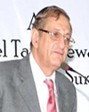
NMOGS Oration : Started in 2006
Menopaused management-Revisited
Dr Behram Anklesaria

Slide 3
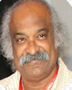
NMOGS Oration : 2007
Understanding Women
Dr P C Mahapatra

Slide 4
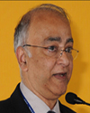
NMOGS Oration : 2008
Surgery for infertility -Is it dead?
Dr Kurian Joseph

Slide 5
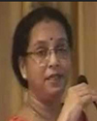
NMOGS Oration : 2009
My Patients My teacher
Dr Surekha Mude

Slide 6
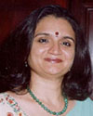
NMOGS Oration : 2010
I have learnt lessons in life
Dr Mandakini Parihar

Slide 7
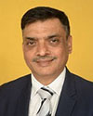
NMOGS Oration : 2011
Is technology causing more grief than relief
Dr Uday Thanawala

Slide 8
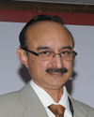
NMOGS Oration : 2012
Diagnosis and management of adnexal masses - a dilemma in clinical practice
Dr Pratap Kumar (Manipal)

Slide 9
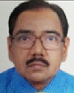
NMOGS Oration : 2013
Safe Patient Safe Doctor
Dr P C Jain

Slide 10
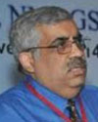
NMOGS Oration : 2014
Compensation-How Much is Too Much
Dr Neeraj Nagpal

Slide 11
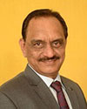
NMOGS Oration : 2015
Infertility: Facts, Fallacies & Future
Dr Sham Kulkarni

Slide 12
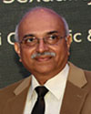
NMOGS Oration : 2016
Promoting female sexuality health and rights in India
Dr Narayana Reddy

Slide 13
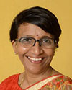
NMOGS Oration : 2017
Still Birth -The Enigma Unresolved
Dr Bharati Morey

Slide 14
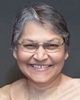
NMOGS Oration : 2018
Respectful Maternity Care
Dr Evita Fernandez

Slide 15
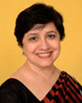
NMOGS Oration : 2019
Every week counts ………..!
Dr Anu Vij

Slide 16
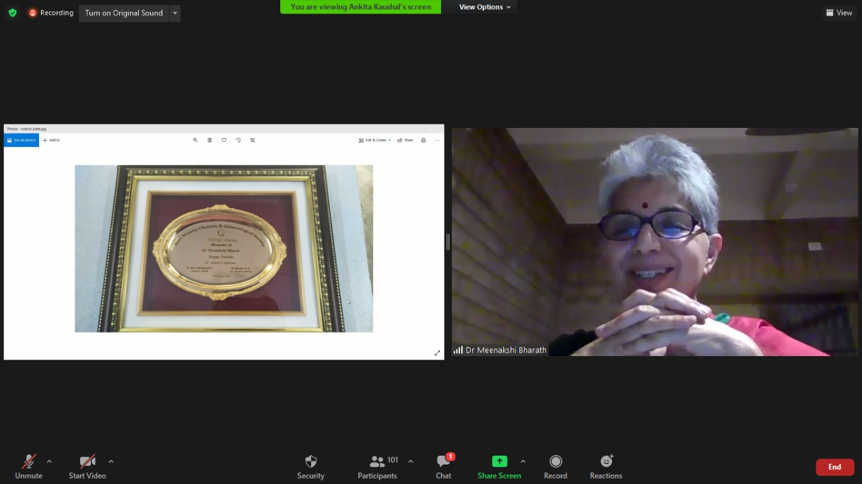
NMOGS Oration : 2020
Happy Periods!
Dr Meenakshi Bharath

