Slide 1

Navi Mumbai
Obstetrics & Gynaecological Society
NMOGS ORATION
Notes:
In the year 2006, NMOGA matured into Navi Mumbai Ob-Gyn Society. This was the turning point and we have never looked back. Since 1993 we have been having an Annual Conference every year. Integral part of the Annual Conference were two important and prestigious orations.
Mayer Organic oration after completing pre decided years of funding became NMOGS oration. Since then very senior Gynecologists have delivered this oration. Every alternate year Past President has the honour to deliver NMOGS oration on the topic of his/her choice.

Slide 2

UPDATES 2006
NMOGS Oration : Started in 2006
Menopaused management-Revisited
Dr Behram Anklesaria

Slide 3
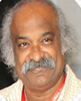
UPDATES 2007
NMOGS Oration :
Understanding Women
Dr P C Mahapatra

Slide 4
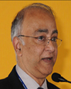
UPDATES 2008
NMOGS Oration :
Surgery for infertility -Is it dead?
Dr Kurian Joseph

Slide 5
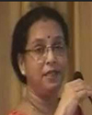
UPDATES 2009
NMOGS Oration : 2009
My Patients My teacher
Dr Surekha Mude

Slide 6
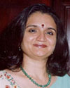
UPDATES 2010
NMOGS Oration : 2010
I have learnt lessons in life
Dr Mandakini Parihar

Slide 7
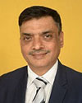
UPDATES 2011
NMOGS Oration : 2011
Is technology causing more grief than relief
Dr Uday Thanawala

Slide 8
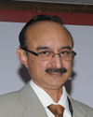
UPDATES 2012
NMOGS Oration : 2012
Diagnosis and management of adnexal masses - a dilemma in clinical practice
Dr Pratap Kumar (Manipal)

Slide 9
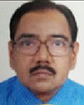
UPDATES 2013
NMOGS Oration : 2013
Safe Patient Safe Doctor
Dr P C Jain

Slide 10
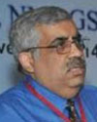
UPDATES 2014
NMOGS Oration : 2014
Compensation-How Much is Too Much
Dr Neeraj Nagpal

Slide 11
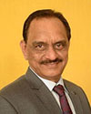
UPDATES 2015
NMOGS Oration : 2015
Infertility: Facts, Fallacies & Future
Dr Sham Kulkarni

Slide 12
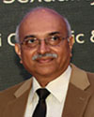
UPDATES 2016
NMOGS Oration : 2016
Promoting Female Sexuality Health and Rights in India
Dr Narayana Reddy

Slide 13
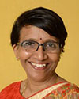
UPDATES 2017
NMOGS Oration : 2017
Still Birth -The Enigma Unresolved
Dr Bharati Morey

Slide 14
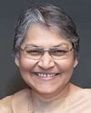
UPDATES 2018
NMOGS Oration : 2018
Respectful Maternity Care
Dr Evita Fernandez

Slide 15
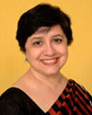
UPDATES 2019
NMOGS Oration : 2019
Every week Counts...........!
Dr Anu Vij

Slide 16
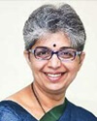
UPDATES 2020
NMOGS Oration : 2020
Happy Periods...........!
Dr Meenakshi Bharat

Slide 17
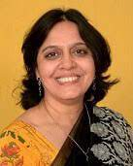
UPDATES 2021
NMOGS Oration : 2021
"Implementing Safety= Adding Quality”
Dr Sucheta Kinjawadekar

Slide 18
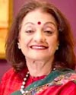
UPDATES 2022
NMOGS Oration : 2022
"PCOS and the Forgotten Uterus”
Dr Duru Shah

Slide 19
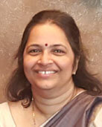
UPDATES 2023
NMOGS Oration : 2023
"Changing Paradigms of Practice”
Dr Mini Nampoothiri

Slide 20
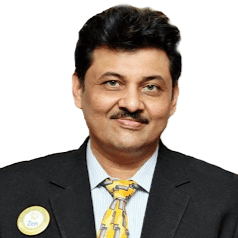
UPDATES 2024
NMOGS Oration : 2024
Complecations: Detect-Correct - Prevent
"COPING WITH FAILURES”
Dr Roy Patankar

Slide 21
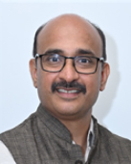
UPDATES 2025
NMOGS Oration : 2025
Theme: EVERY DROP COUNTS: HEMORRHAGE IN OBSTETRICS &
GYNAECOLOGY
Dr Rahul Wani
“STUMPED BUT NOT OUT”

Slide 22
UPDATES 2026
NMOGS Oration : 2026
Theme:
Dr
Topic
Photo

