Slide 1

Navi Mumbai
Obstetrics & Gynaecological Society
Dr Pradeep Khopkar Oration
YEAR : 2006-2023
Notes:
Once upon a time there was a time when a new City was planned and developed near Mumbai. As the population grew
New and young doctors came and settled here to serve mothers in society. Those were the days when for any major health issue patients will go to Thane , Home deliveries was quite a trend and obstructed labour used to travel to Thane.
Or Mumbai. Creek bridge developed and flux started flowing to Mumbai.

Slide 2


Notes:
Navi Mumbai was growing so also number of gynaecologists grew.
In the year 1996, an idea proposed over a casual discussion by
a handful of like minded Obstetricians , seemed to click and take root. THE
IDEA was to have an Association of OUR OWN here in Navi Mumbai and
to have our clinical meetings here itself;

Slide 3
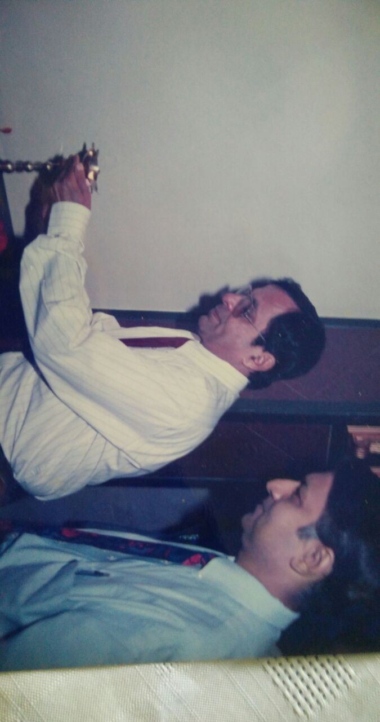
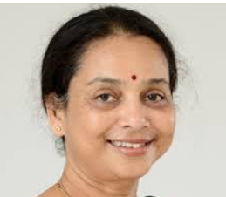
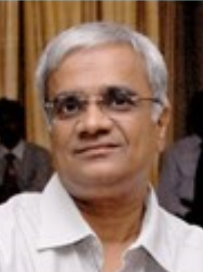
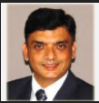
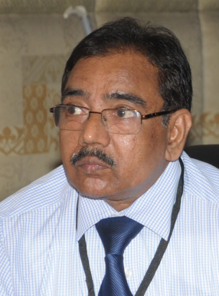
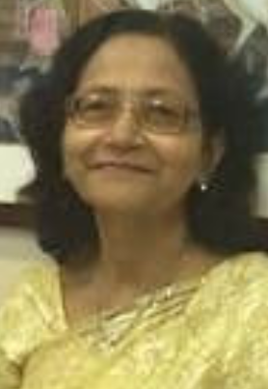
Birth of Navi Mumbai Ob Gyn Association :1996
Notes:
Reason? It was becoming difficult to go to Mumbai for clinical meetings
and updating every now and then and leaving behind the growing practice,
unattended. Also the need to be independent and have an identity of own
was compelling.
This led to the birth of Navi Mumbai Ob-Gyn Association in 1996.
Dedicated members like Dr Pradeep Khopkar, Dr Pratibha Utage, Dr Uday
Thanawala, Dr Vishnu Agarwal, Dr Surekha Mude Dr Mrs Khopkar , Dr PC jain ,were instrumental in
nurturing and providing all sorts of supports to the Association

Slide 4

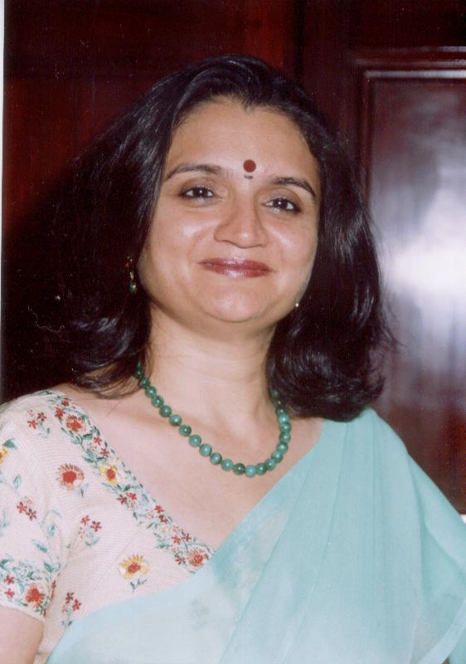
Navi Mumbai Obs-Gynaec Association
turns
Navi Mumbai Obs-Gynaec Society.
Affiliation to FOGSI
Notes:
As time passed, the Association
grew and a far sighted member felt the need to join hands and be merged
with FOGSI. The credit of doing this goes to Dr Mandakini Parihar, who
sadly is no longer between us.
In the year 2006, NMOGA matured into Navi Mumbai Ob-Gyn Society. This
was the turning point and we have never looked back.

Slide 5
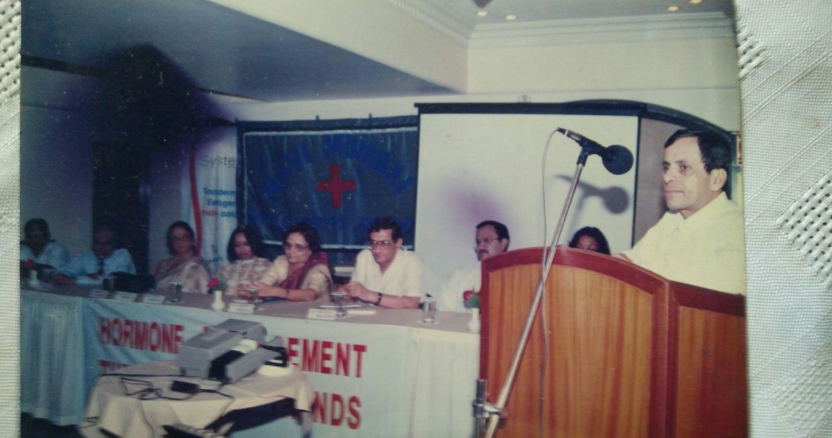
Notes:
We feel proud of having a person of the stature of Dr Khopkar amongst us
and we are privileged to have an Oration instituted in his name every year.
This were being held since beginning.
Dr Pradeep Khopkar is Founder president of Navi Mumbai Association – Society
Dr Khopkar has completed MBBS and MD from JJ Hospital in 1972. After working as a Lecturer at parent institute
He came to Navi Mumbai in 1975. and started his Gynecological and surgical hospital in 1975.
This was probably first such hospital in Navi Mumbai.

Slide 6
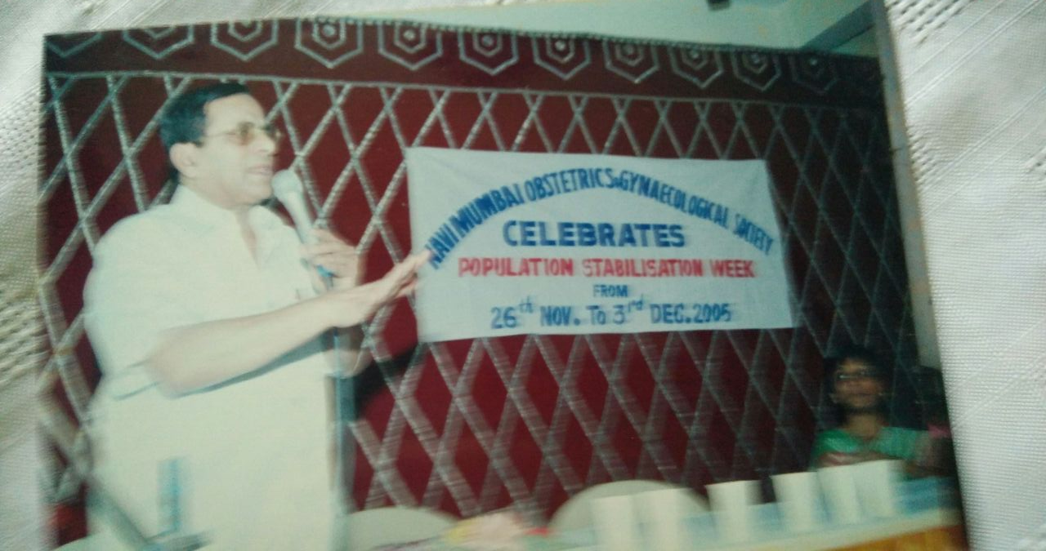
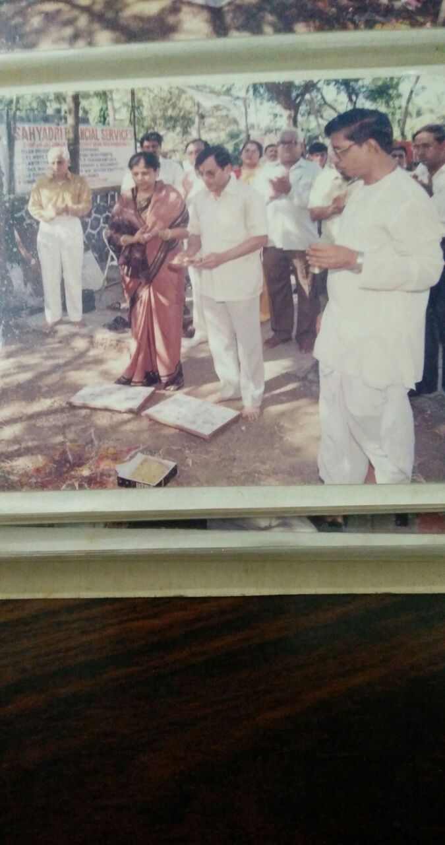
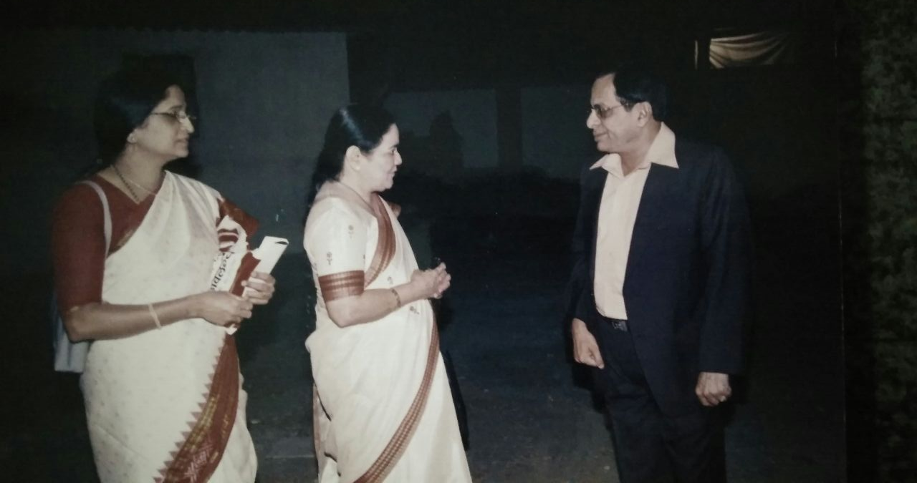
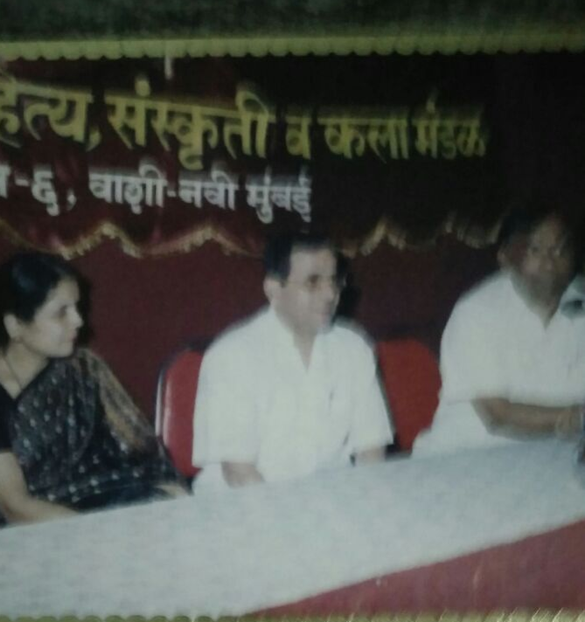
Notes:
Apart from clinical practice he was actively involved in Social and cultural activities happening in and around Navi Mumbai. He was president of Sahity sanskrutiKala Mandal.
He was involved in lot of social activities in Navi Mumbai for welfare and benefits of women in Navi Mumbai.

Slide 7
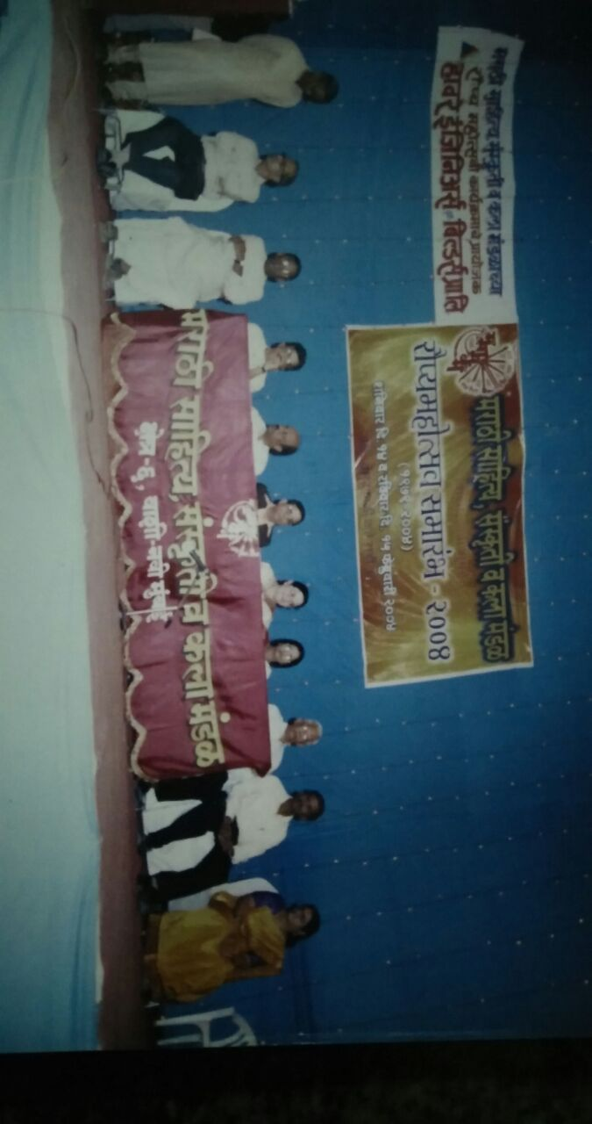

Slide 8
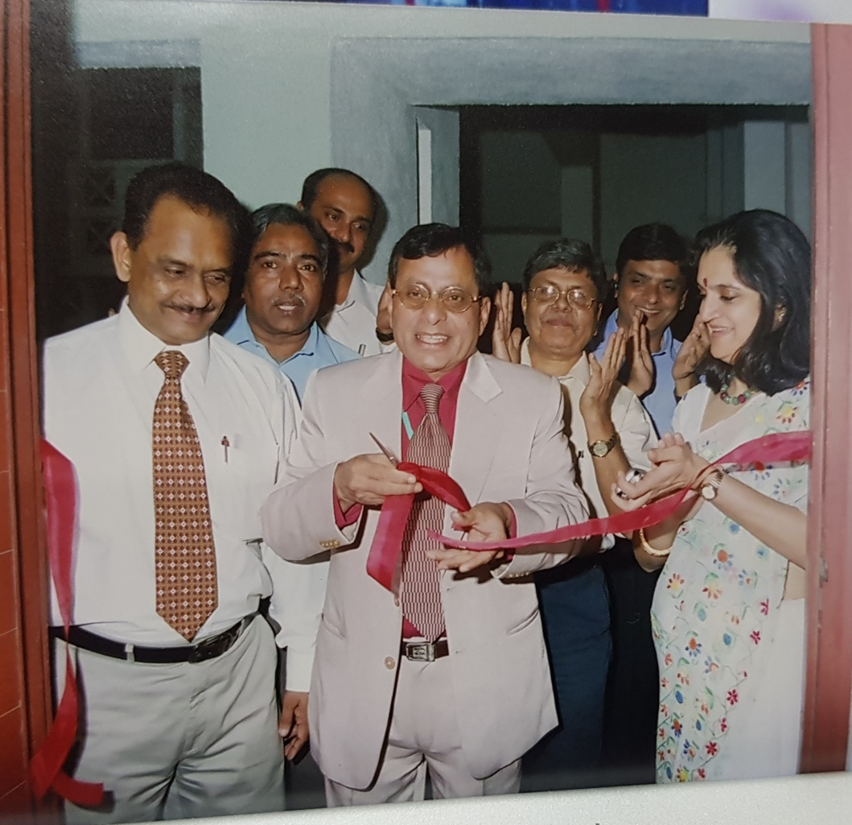
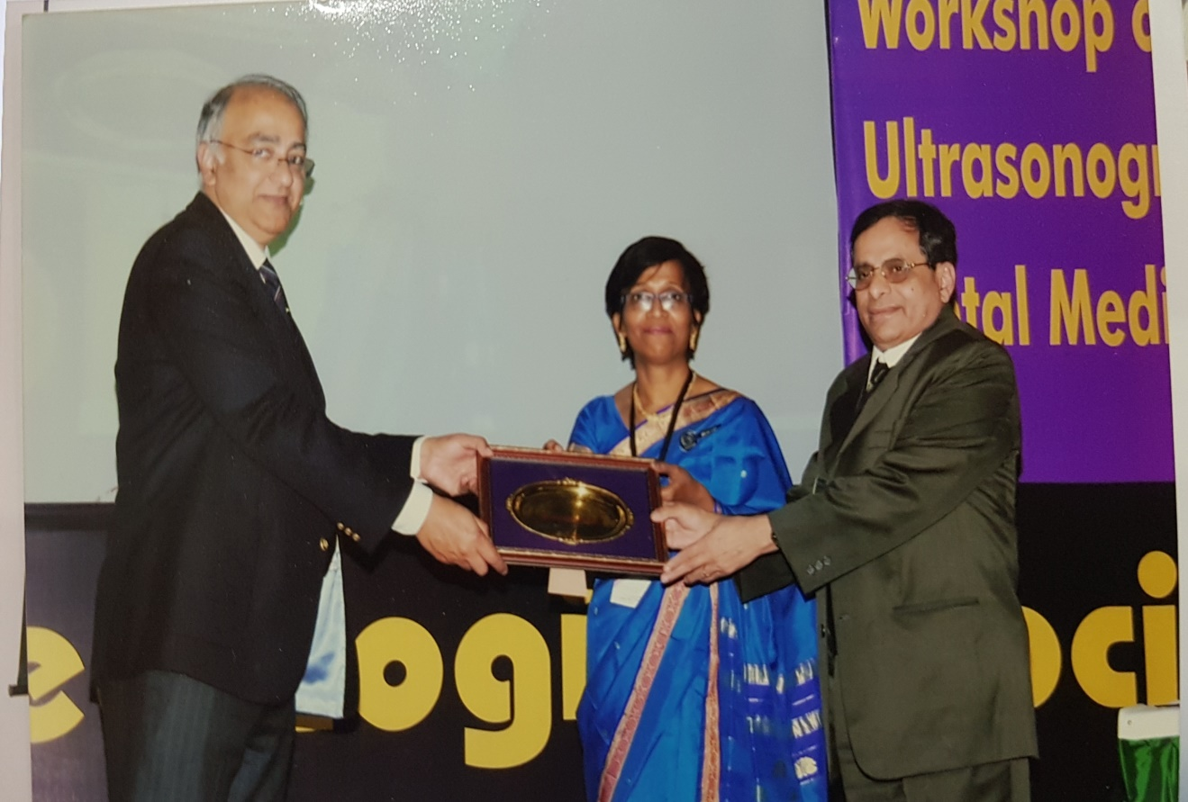
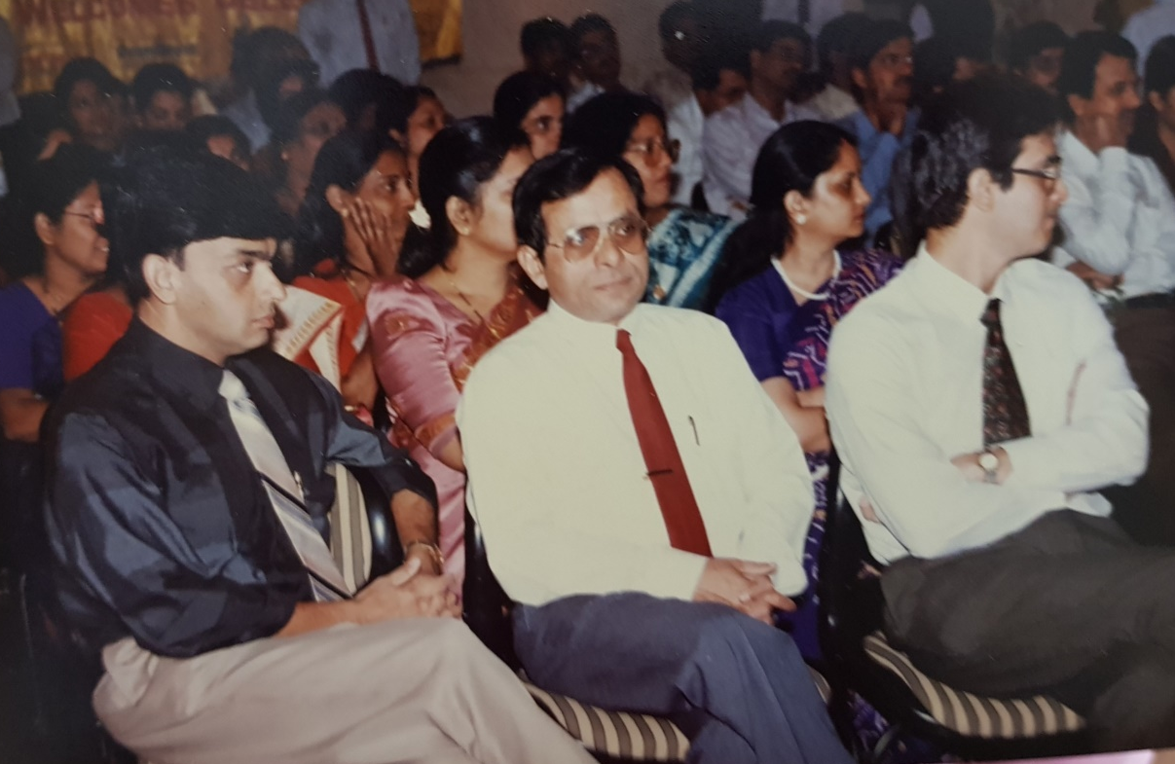

Slide 9
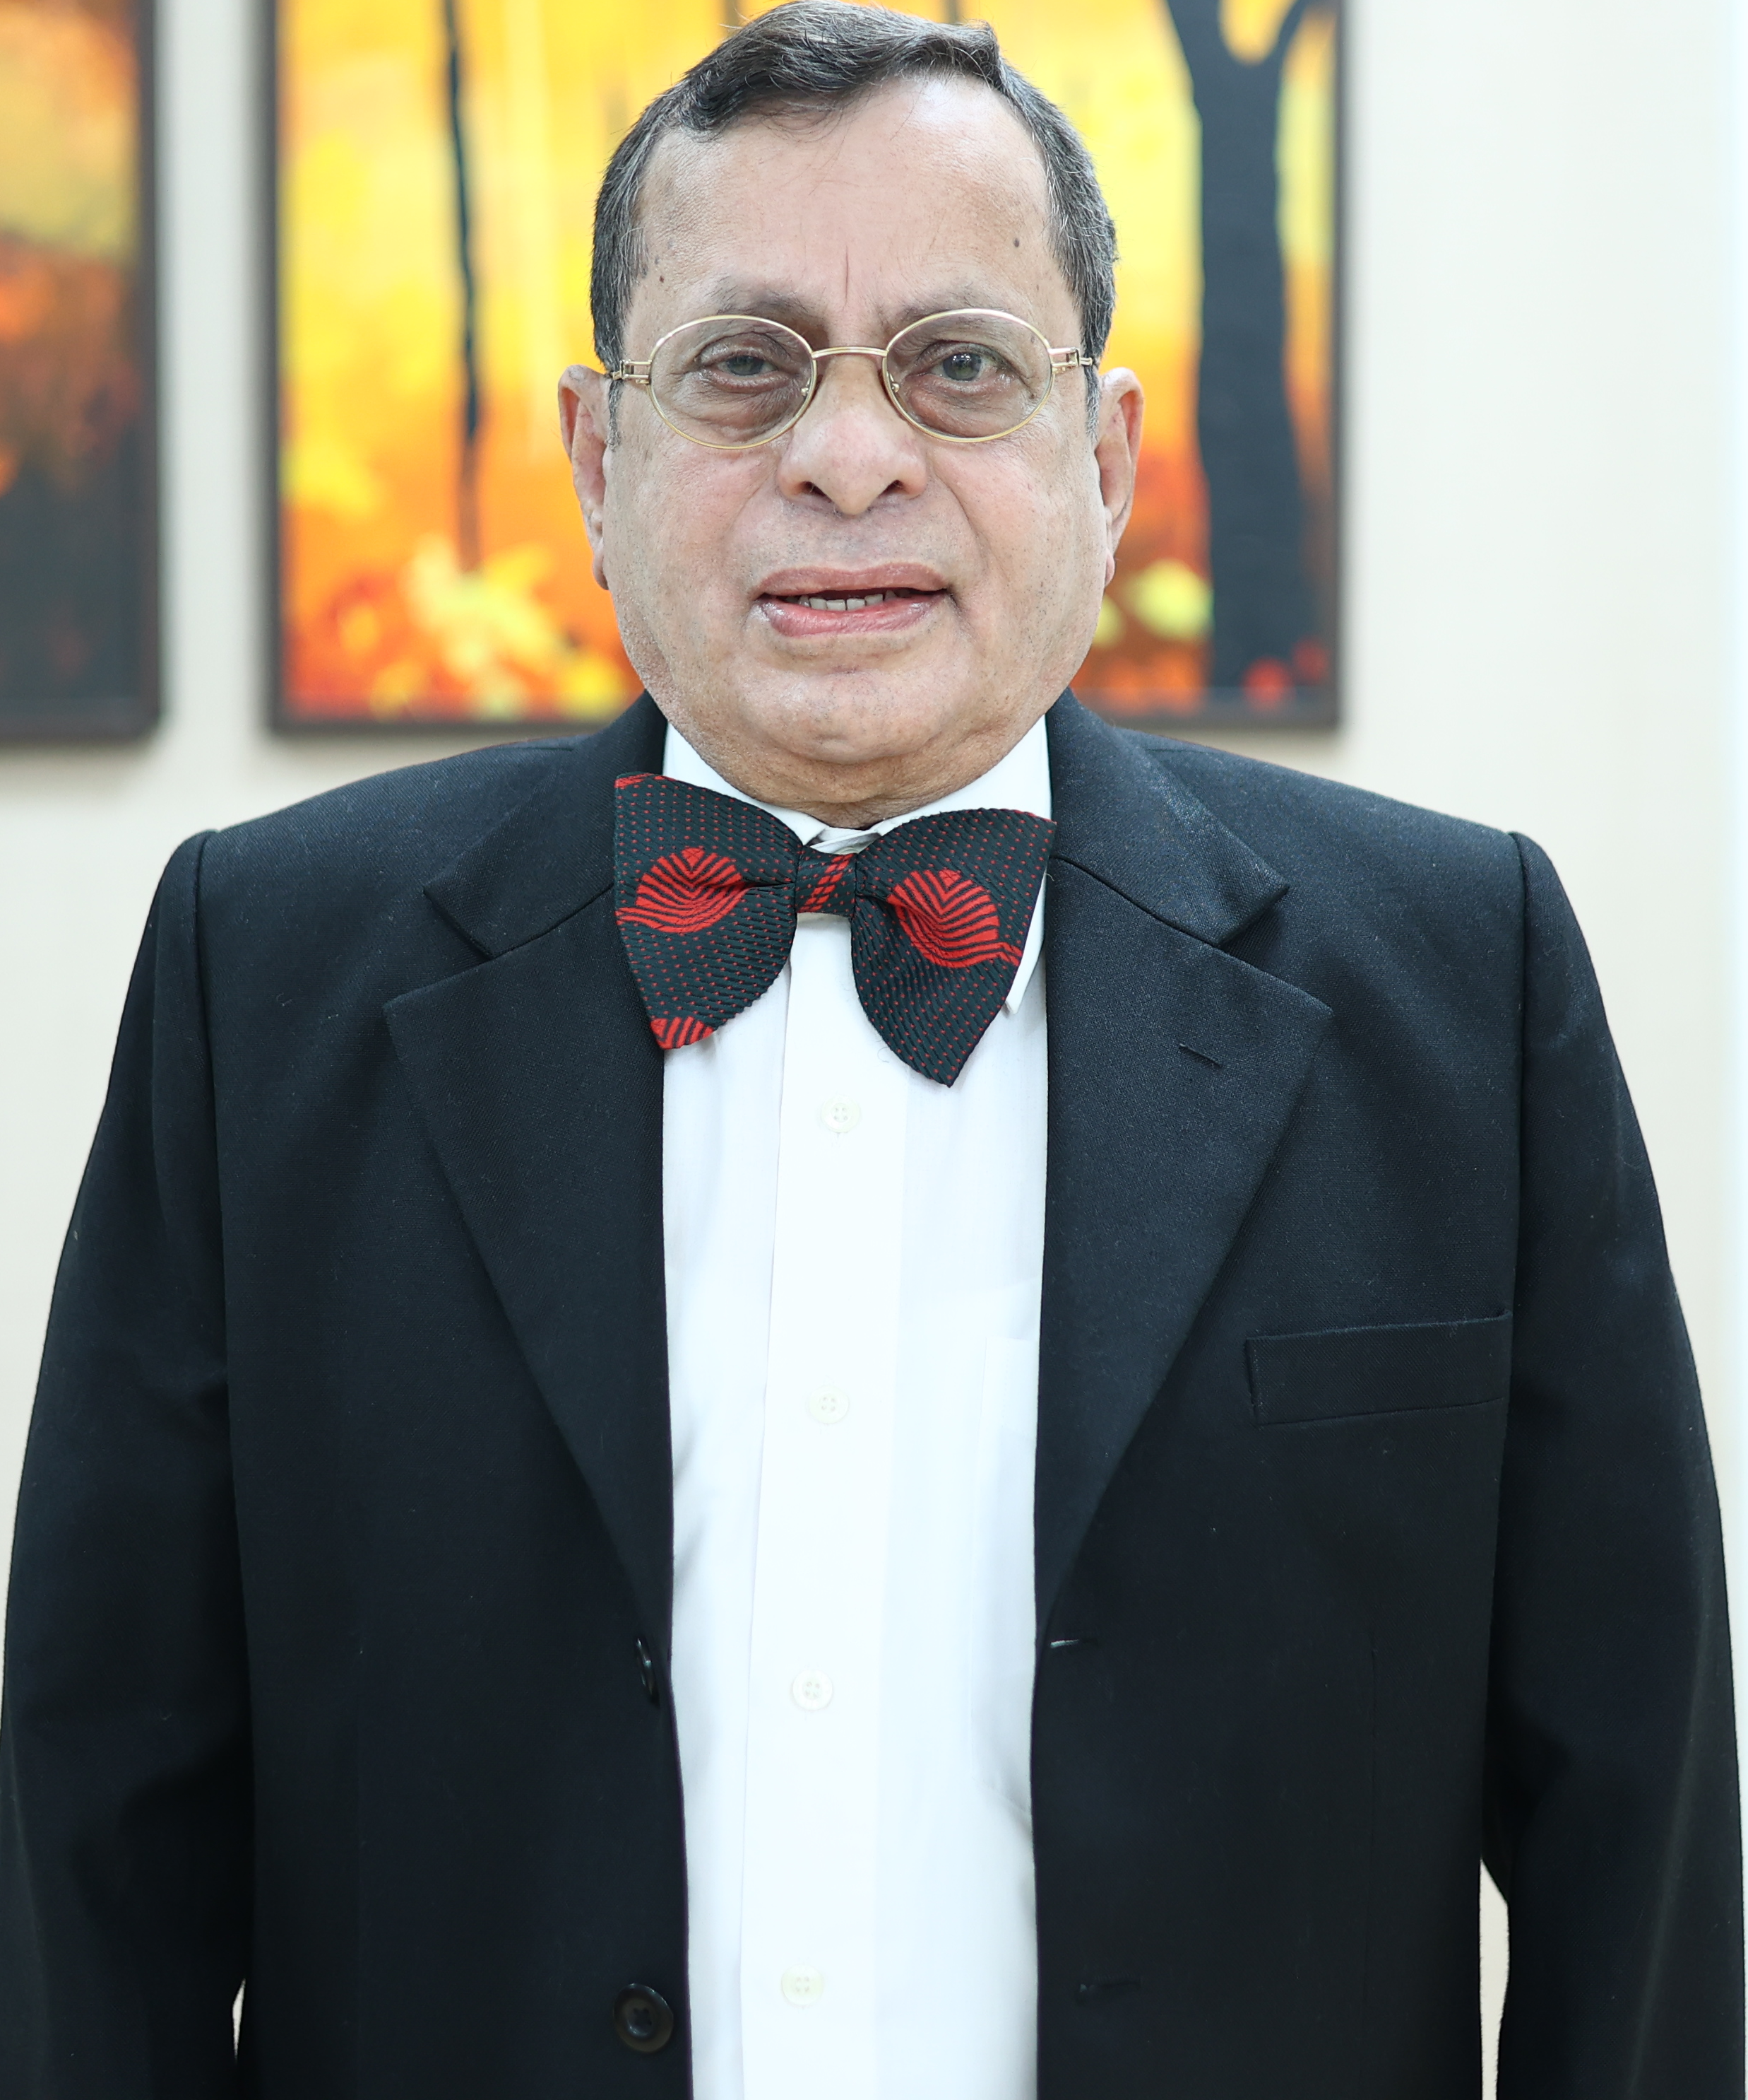
2006………………..
Dr Pradeep Khopkar Oration
Notes:
Dr Khopkar has the distinction of being the First Obstetrician of Navi Mumbai and is credited with laying the first brick in the foundation of NMOGS. He has nurtured this small Society like a father figure not only with the monetary help, but has been there for any and every type of guidance and advice.
Dr Pradeep Khophar Oration was instituted in the name of the Founder President of Navi Mumbai Ob-Gyn Association and was carried forward when the Association became a Society.
We feel proud of having a person of the stature of Dr Khopkar amongst us and we are privileged to have an Oration instituted in his name every year.

Slide 10
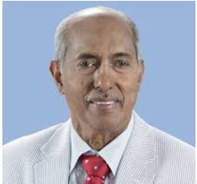
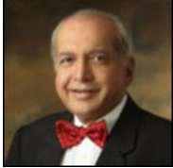
Updates 2006 : Updates 2007
9th Annual Conference 10th Annual Conference
Dr C N Purandare :
Hysterectomy : Introspection
Dr V P Paily
Incontinence in women
Notes:
We have a galaxy of Orators from across India and abroad who have delivered this Oration and made us feel proud.

Slide 11

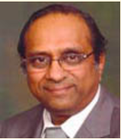
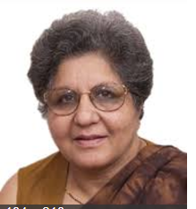
Updates 2008 Updates 2009
11th Annual Conference 12th Annual Conference
Dr Soniya Malik Estrogens : The Good The Bad and the Unexplained
Dr S Suresh
Fetal Medicine – What have we Achieved

Slide 12

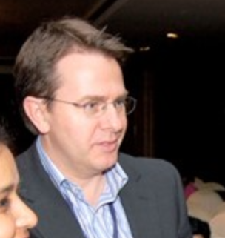
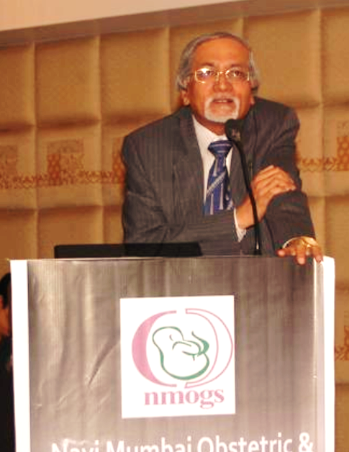
Updates 2010 Updates 2011
13th Annual Conference 14th Annual Conference
Grey Zone in Obstetric Sonogram
Dr P K Shah
Ethical issues in Multiple Pregnancies Dr Glenn Gardener

Slide 13
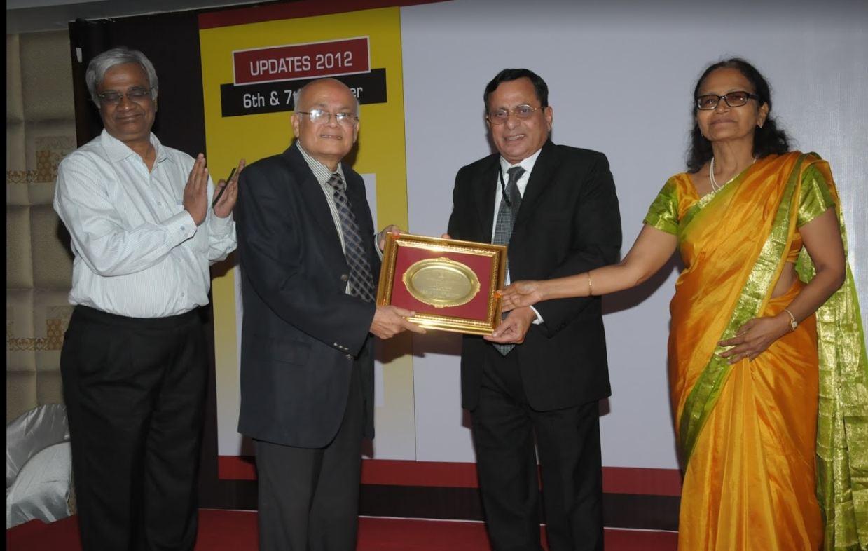
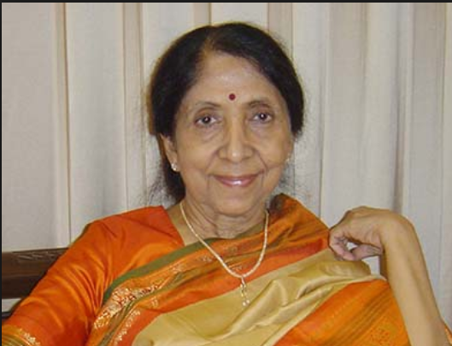
Updates 2012 Updates 2013
15th Annual Conference 16th Annual Conference
My simple contributions to the Clinical Obstetrics Practice
Dr Alok Debdas
Male Infertility
Dr Indira Hinduja

Slide 14
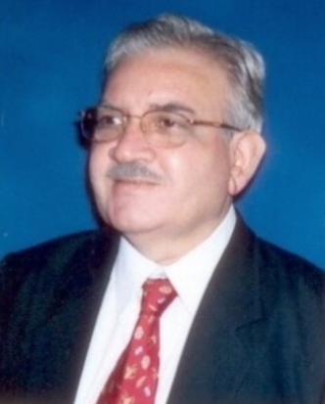
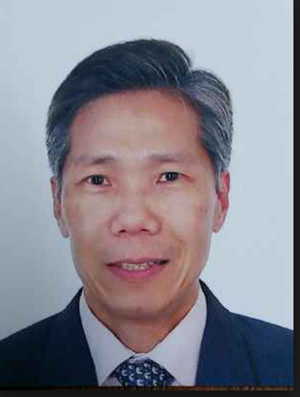
Updates 2014 Updates 2015
17th Annual Conference 18th Annual Conference
Changing Scenario Of Medical Practice In India
Dr Lalit Kapoor
Can the Holistic Practice of Urogynaecology
Improve the Sexual Health of Women?
Dr Roy NG

Slide 15
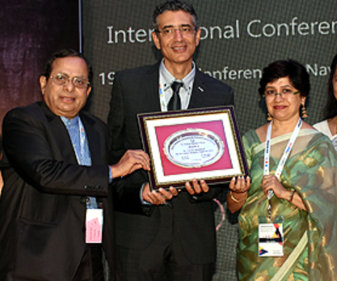
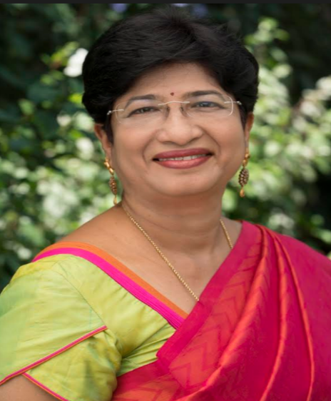
Updates 2016 Updates 2017
19th Annual Conference 20th Annual Conference
Dr Gita Arjun
I Me Myself : Surviving as Woman in Medicine.
Sex & Cultural Religion Right and Ethics
Dr Yacov Reisman

Slide 16
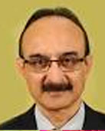
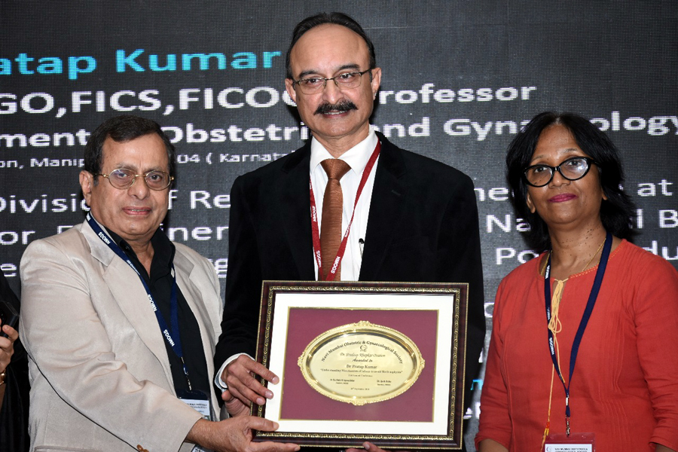
Updates 2018
21st Annual Conference
Mechanism of Labour.
Dr Pratap Kumar
Dr Pratap Kumar

Slide 17
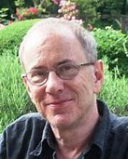
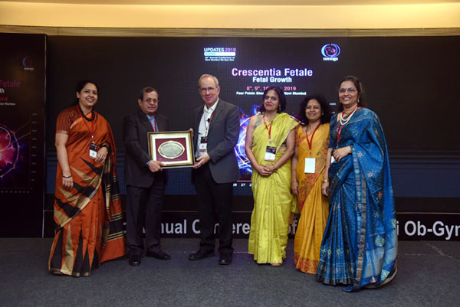
Updates 2019
22nd Annual Conference
Prof. Jason Gardosi
From ReCoDe to SCOR, from GROW to GAP:
Prof. Jason Gardosi

Slide 18
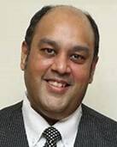
Updates 2020
23rd Annual Conference
The new sexuality of adolescents 2020 and beyond
Dr Avinash De Sousa

Slide 19
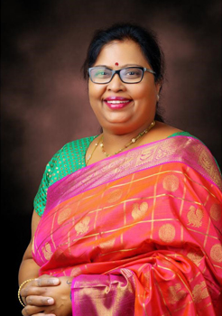
Updates 2021
24th Annual Conference
“Women’s Empowerment Way Forward for SDG Goals”
Dr S. Shantha Kumari

Slide 20
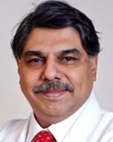
Updates 2022
25th Annual Conference
Reproductive Genetics
Dr Hrishikesh Pai

Slide 21
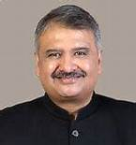
Updates 2023
26th Annual Conference
Instrumental Vaginal Delivery in Modern Obstetrics
Dr Jaydeep Tank

Slide 22
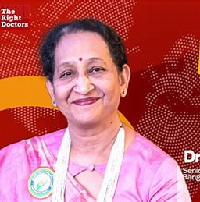
Updates 2024
27th Annual Conference
Complecations: Detect –Correct-Prevent
Instrumental Vaginal Delivery in Modern Obstetrics
Dr Sheela Mane
DIC NAVIGATING IN PREGNANCY

Slide 23
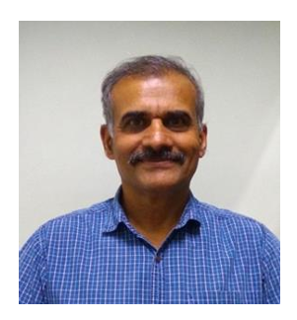
Updates 2025
28th Annual Conference
EVERY DROP COUNTS: HEMORRHAGE IN OBSTETRICS & GYNAECOLOGY
Dr Vivek Joshi
AORTIC CLAMPING FOR LIMITING BLOOD LOSS IN CAESAREAN
HYSTERECTOMY FOR PAS

Slide 24
Updates 2026
29th Annual Conference
Theme:
Photo
Dr
Topic

